Slide 1


Why is the lawyer mad at me?
Search
An Overview
Of Legal and some Compliance High Notes

Slide 2


Intro to the Legal Team
[. ]
[. ]
[. ]

Slide 3


Why We Need a Compliance Program
A Manifesto

Slide 4
Compliance programs can have different goals
based on the underlying business - here we are focusing on organization-wide goals and pointers but will also touch on business specific topics.
We are growing incredibly fast and this presentation is designed to give a high level of things to keep in mind for new hires and as a refresher

Slide 5
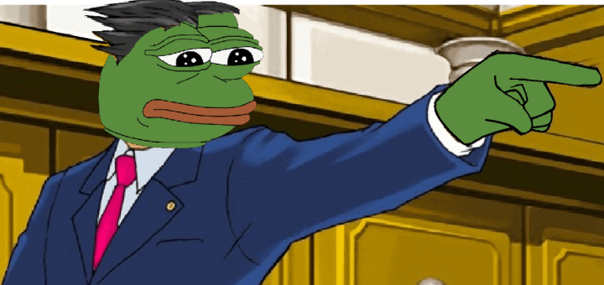
So what are we talking about today?
Policies + Best Practices

Slide 6
Our Principles
Code of Conduct

Slide 7

TL;DR*
Search
Core Values + Standards of Conduct
Save
Cancel
*Yes, you actually have to read these

Slide 8
Key Components:
-Comply with Law
- Comply with applicable Policies
- Use Confidential information & Resources only for authorized purposes
- Foster a collegial work environment; memes are welcome but discrimination/harassment are not
- Ensure your actions reflect positively on us (internally and externally)
- Act ethically and avoid conflicts of interest
These apply to all & the business will administer (enforce) the policies (which may differ based on your position).

Slide 9

To sum it up: Dont do stupid shit.
Search
Save
Cancel

Slide 10

You might be asking:
What is -Material Non-Public Information (MNPI)
Definition
means non-public information that could reasonably influence the decision of a person to trade a security or digital asset. MNPI includes information provided by one party to another and designated as “confidential” or “proprietary” or otherwise provided in a manner indicating an intention that such information will not be disclosed. This may include non public information relating to a party’s past, present, or future trading activity or plans, prospects, business, operations and results of operations. Material Nonpublic Information may also include non-public information relating tothe timing and circumstances of digital asset issuances, exchange listings, forks, vesting/unlocking, vulnerabilities, court orders etc.
exchange listings, court orders, and other circumstances.
Generally, be aware of when you have information that is non-public and your obligations to safeguard it.

Slide 11



Stuff that isn't MNPI?
Material Nonpublic Information does
not include information that (i) is or becomes publicly available other than through the actions of
the recipient, (ii) is developed independently by the recipient prior to receipt of and without the
benefit of non-public information, or (iii) becomes available to the recipient on a non-confidential
basis from a source other than the providing party or was known to the recipient on a
non-confidential basis prior to its disclosure by the disclosing party.

Slide 12
Document Retention
These will be implemented across the organization but will have procedures specific to each department.

Slide 13
A Necessary Step
*Document retention standards dictate how you must treat information of the business - this means storing documents only in official repositories and communicating only on official channels so that we are able to manage obligations with respect to storing and disposing of records in compliance with law and putting through document holds when required to disclose records by law (litigation/regulators).
*This involves building our IT infrastructure for storage - folders with different permissions for different teams.
*We expect everyone to take their obligations seriously with respect to this policy - if you are storing locally and copies of records slated to be disposed of are lingering, you would be required to produce these records in the event of litigation or regulatory inquiry - this would undo all of the work done to get these policies and standards in place.
Organization-wide

Slide 14
Best
(and not so Best)
Practices
Just some quick examples of what to do/ what not to do.

Slide 15

Things that make legal happy
Let's review

Slide 16
If you ever have questions on whether something is okay, just ask:
We have an intake email address for the legal department: [. ]
It is easier and safer to ask for an okay in advance.
Let's run through some questions asked to date.

Slide 17

If you feel like you need more training on specific compliance points, we are happy to help with those as well.
For instance, fun fact -- [ INSERT SOME REGULATORY ISSUE THAT REQUIRES A CERTAIN ACTION(S) ]

Slide 18

Things that make legal unhappy
Let's review

Slide 19

Engagement farming
Dance like nobody is watching, tweet like legal keeps a creepy big brother type list
Social Media

Slide 20


Don't say stupid stuff
Tips
Don't disclose material non-public or sensitive information (including organization information and that of our partners)
When playing on the interwebs:
Think before you post, the internet is foreverrrrrrr
Guard information about other departments/affiliate businesses because you will have less of a sense what information is sensitive

Slide 21
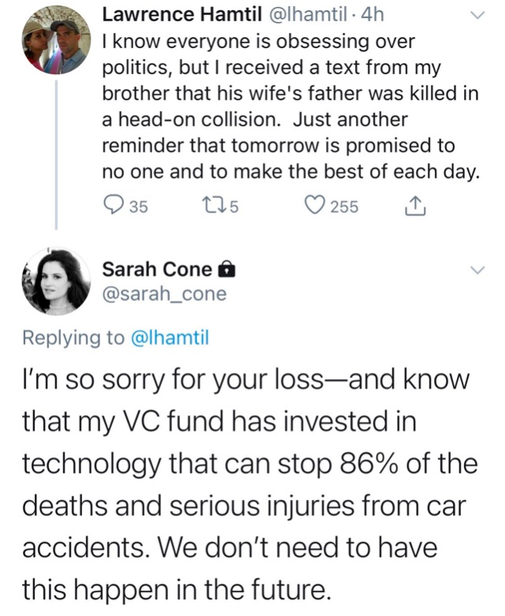
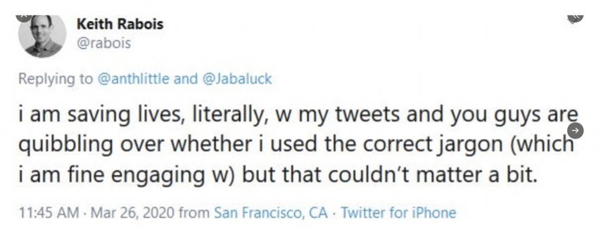
Ooooof
Social Media
General Cringe

Slide 22
[Insert Social Media example of saying/doing something sensational/easily disproved/other own goal]
Engagement farming
Social Media
Stupid
Stuff

Slide 23
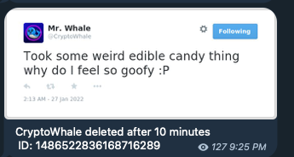
[Insert Social Media example of disclosing something that undermines public confidence in the founder/officer having common sense - wen am I not on drugs? Code audits? What code audits?]
Oversharing
Social Media
TMI

Slide 24
Oversharing
[Insert Social Media example of disclosing something that was not intended to be disclosed]
Social Media
MNPI

Slide 25
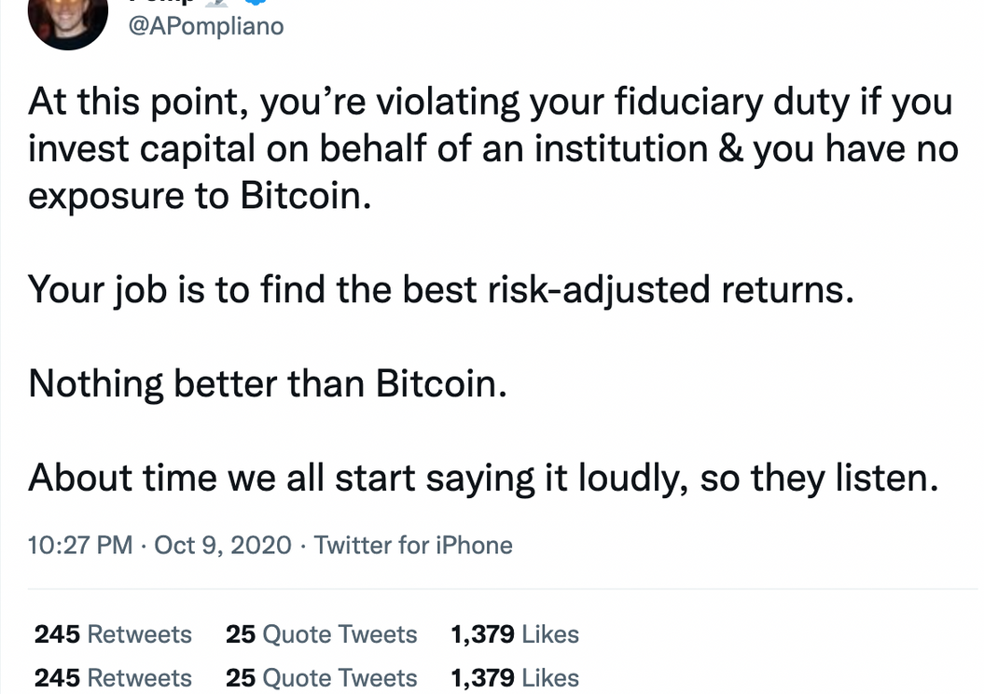
Pumping your bags (+inv advice)
[Insert Social Media example of touting w/o disclosure like the below
but for a portco/bag you hold]
Social Media
Touting

Slide 26
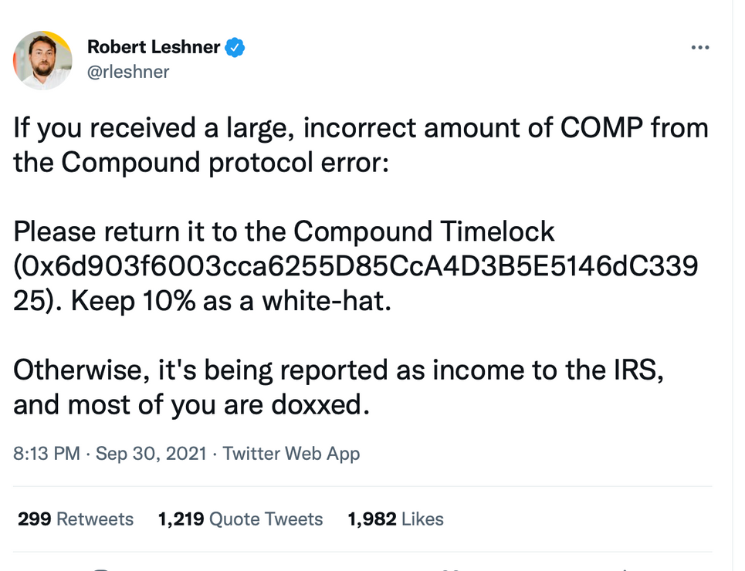
[Insert Social Media example of an emotionally charged post]
Retractions
Social Media
Things you
wish you could take back

Slide 27


Any questions?
Q&A

Slide 28
Any questions?
Q&A From the Comment Section

Slide 29
Thank you!
Q&A

